Slide 1


Growing Partnership
East Coast Metallic and National Grid
Presented by:
Deborah Ehmann,
Craig Saperstein,

Slide 2
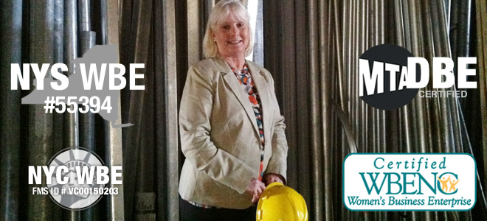
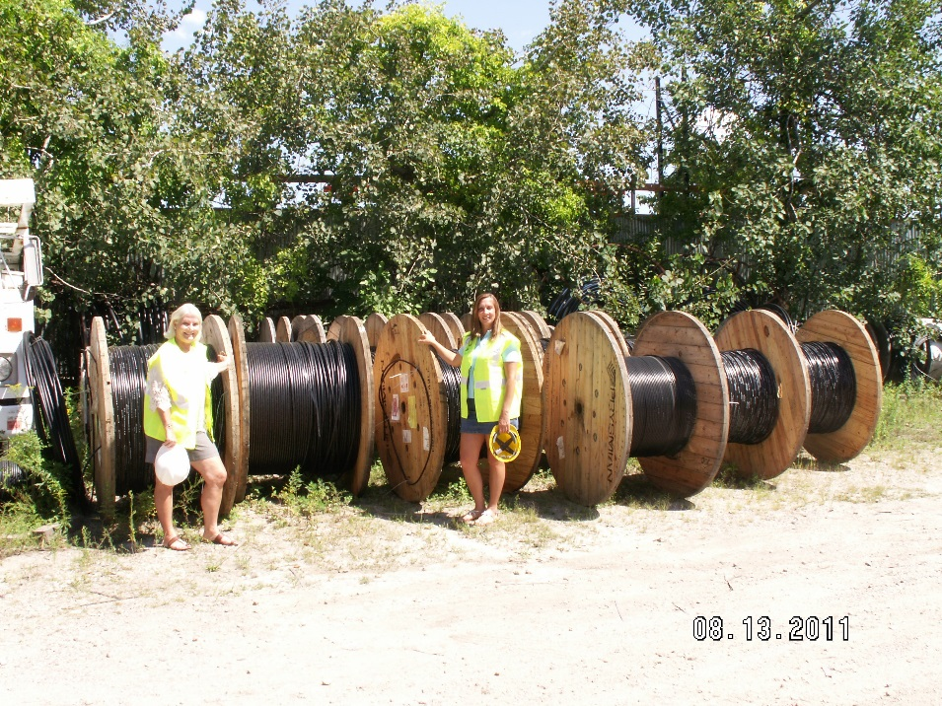
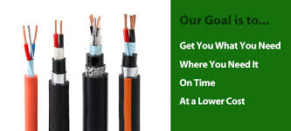
Who We Are:
Company History
Supplier of Electrical, Cable, Data, Security and Safety Products
Capability Statement
Incorporated Since 2001
Bonding up to $5MM

Slide 3
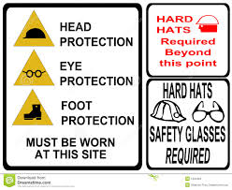
What We Provide:
SAFETY | ELECTRICAL | DATA COMM - SECURITY
Personal Protection | Conduit & Raceways | Copper Solutions
Situational Protection | Boxes & Enclosures | Fiber Optic Solutions
Facilities | Fittings, Wire & Cable | Racks, Cabinets, Tools
Signage - Training | Surge, Power Protection | Cable MGT
First Aid | Termination, Tape, Data Comm., Electronics Dem | Low Volt Spec. Wire & Cable
 | Slicing & Marking | Physical Security Solution
 | Wiring Devices | Commercial AV
 | Lamps, Fixtures, Ballasts | Networking Solutions, Installation Supplies
 | Elec. Dist. Equip. | Secure Network Solutions
 | Controls, Relays, Timers, Transformers | Power Dist. Prot. & Cooling OSP Products
 | Tools & Tester | Residential Solutions
 | Industrial & Maintenance Supplies | Test Equipment

Slide 4
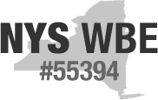
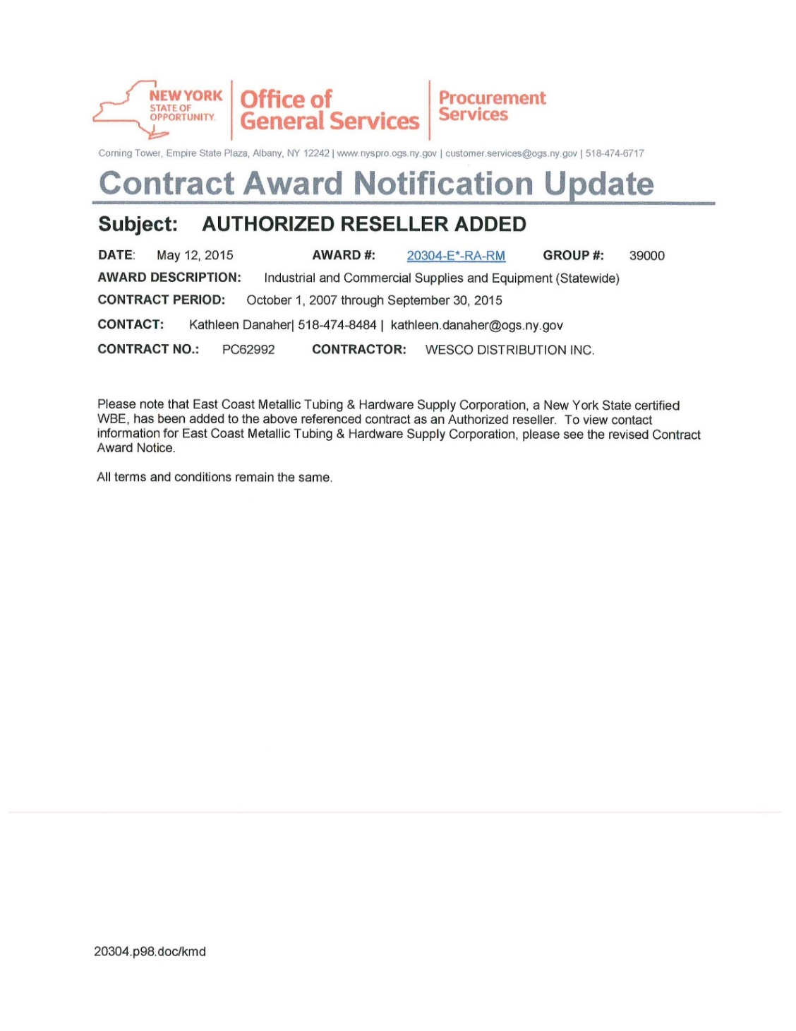




Certifications:
MSW-BE

Slide 5
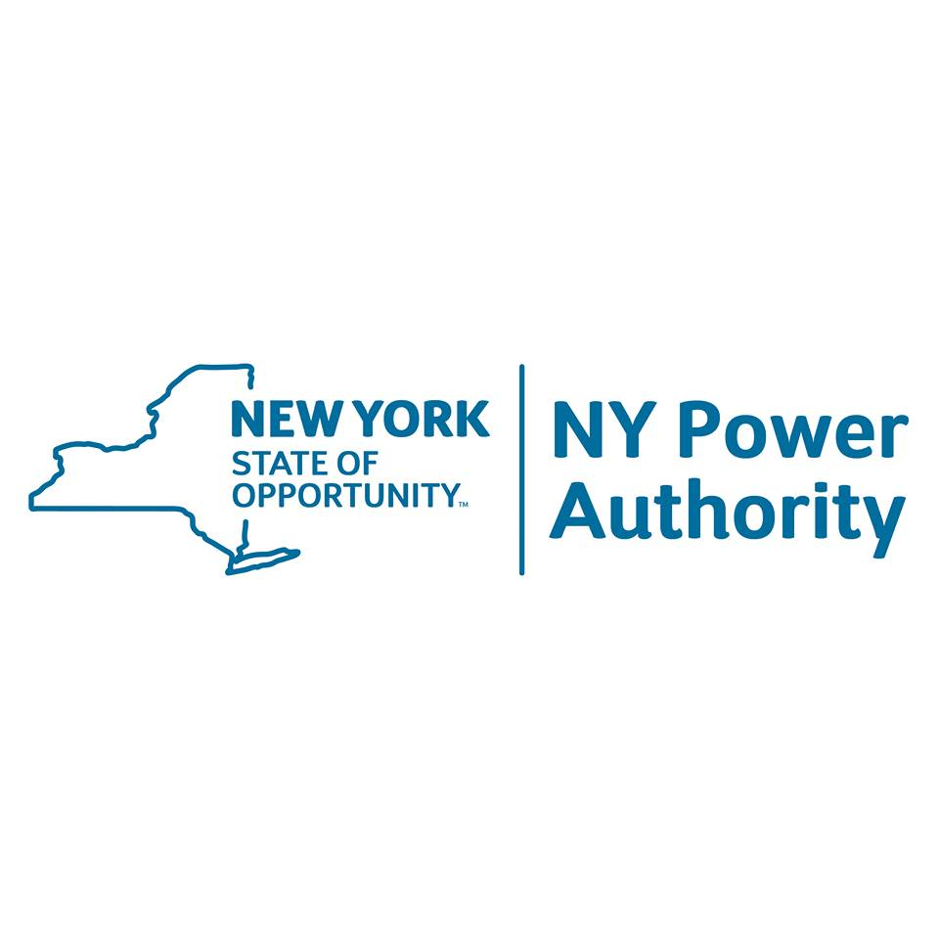













Our Valued Customers:

Slide 6
Proven Reliability:
Utility Experience:
NATIONAL GRID:
National Grid:
* Brooklyn Union Gas-KEDNY (May 2013-March 2015)
ADDITIONAL UTILITY EXPERIENCE:
New York Power Authority:
* Massena New York (April 2013-May 2014)
North Atlantic Communications Systems Construction Corporation (October 2001-Present)
* Cablevision – Lightpath
* Verizon - MCI
* Bayview Custom Communications
* Tritech Communications
Con Edison
* Pending

Slide 7
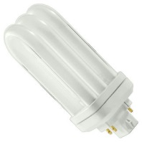

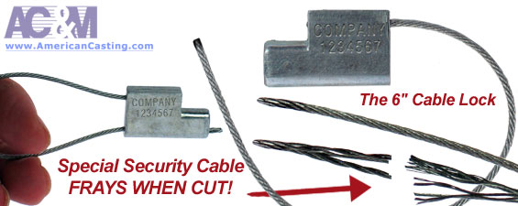
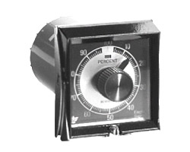

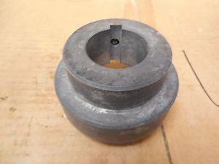
Recent Projects:
Sciame Construction: $1,235,000.00
Light Fixtures
MTA-NYCT: $64,220.00
Cable, Adjustable Security Seals
MTA-NYCT: $9,000.00
Wire – One Conductor #12 AWG
7 Strands Copper
MTA-Bus Company: $76,050.00
Cable, Adjustable Security Seals
DCAS (Department of Citywide Administrative Service): $25,000.00
Paint and Accessories
SCWA (Suffolk County Water Authority): $18.547.91
Timers, Cycleflex, 1 Hour
NYC Department of Sanitation: $1,978.68
Various Couplings

Slide 8
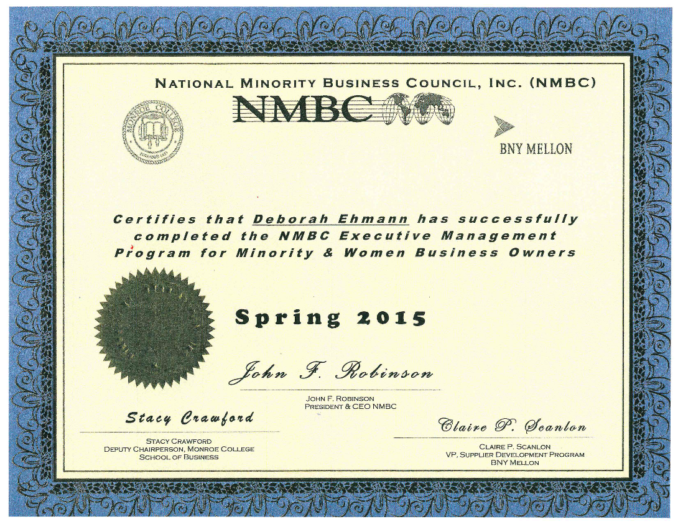
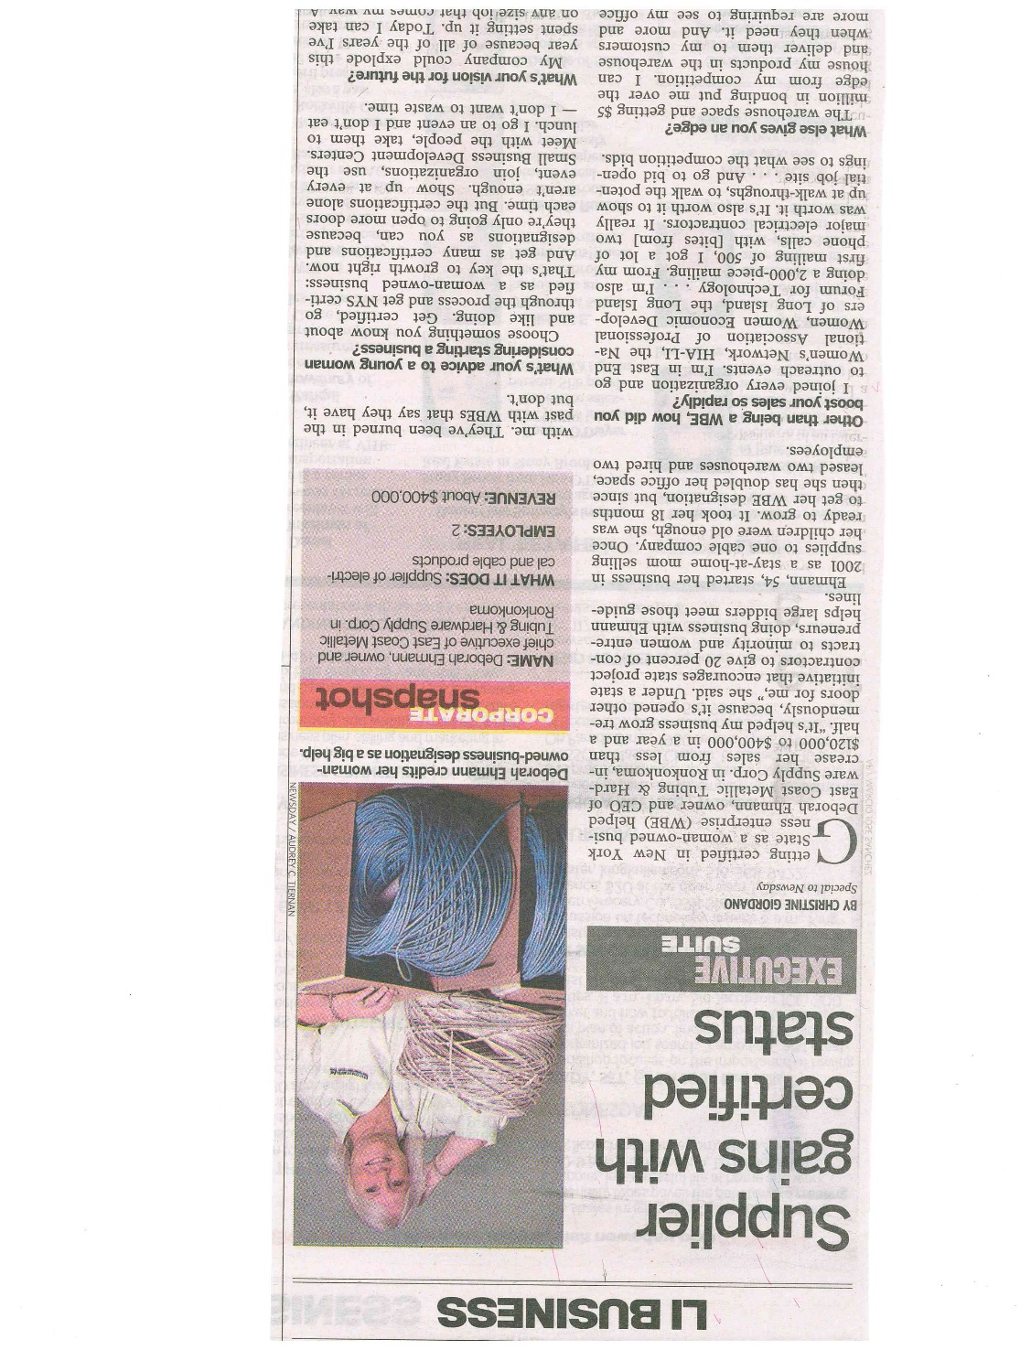


Recent Successes:

Slide 9
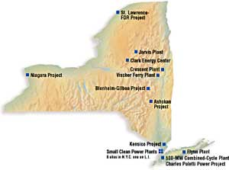

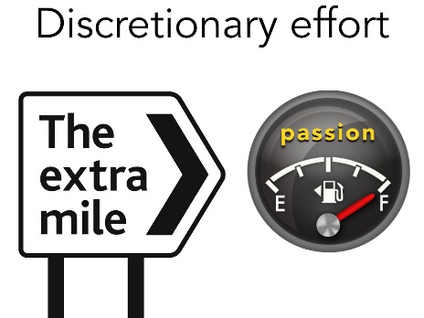
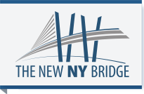

Future Vision For East Coast Metallic:
Working with National Grid and Wesco
Delivering a Quality Product at a Competitive Price
Working with Con Edison
Broadening my Relationship with NYPA
Broadening my Relationship with the MTA
SUNY Stony Brook
Wesco OGS State Contract
Working with CUNY System
Fostering my Relationship with the Tappan Zee Bridge Project/DBE

Slide 10

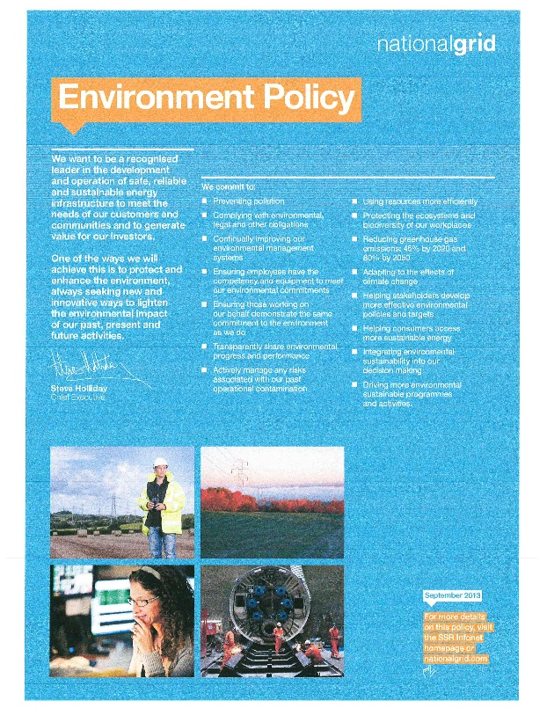

Sustainability:
Social Media:
Utilization of social media and building a reliance on electronic mail to communicate with partners and the community as opposed to using paper products
Recycling:
Emphasis on the importance of recycling within our office by installing a “back-of-paper” policy for printing
Local Suppliers:
Strive to Connect with Local Suppliers in order to Minimize our Carbon Footprint
Partnerships:
Create and Foster Partnerships with Environmentally Conscious Companies, such as National Grid and Wesco

Slide 11
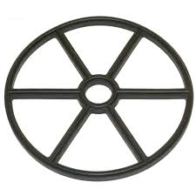
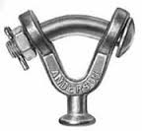
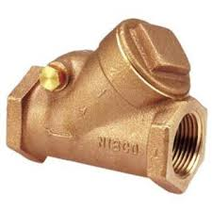
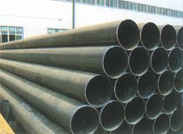
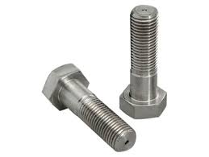

Previous National Grid Projects
BROOKLYN UNION GAS – KEDNY – MAY 2013 – MARCH 2015
HARDWARE:
SWITCHES
PLUG 12 LOCK 0-RINGS
ELBOW WELD 45 DEGREE LONG RADIUS STEE
STAINLESS STEEL BOLTS
SEAL SLEEVE THROUGH FOUNDATION
UNION CAP
PLASTIC DUST CAPS
BRONZE PULL/GRIP LEVER TAPERED DISC GLOBE VALVES
HYDROLIC COMPONENTS – VALVE
DIRECTIONAL VICKERS
LIMITORQUE GASKET
WASHERS
HOUSING COVER GASKET
INLET VALVE GEAR HEAD
GASKET VALVE SEAT
Y-CLEVIS EYE HARDWARE FITTINGS
3/8 PIPE CARBON STEEL- SCHEDULE 40 PIP
$11,485.90

Slide 12
National Grid:
A Company we Respect
“Doing the Right Thing”
Recognized as Company with High Ethical Standards for Many Years
Committed to Providing Safe, Efficient, Reliable Energy to the Customers and Communities they Serve
Committed to Reducing the Causes and Impact of Climate Change
Committed to Working with Governments and Regulators in the U.S. and the U.K. Regarding Energy Policy
Commitment to Personal and Work Safety
Lineman Safety Day
Supplier Code of Conduct
Commitment to Supplier Diversity / WBE

Slide 13
Value Added Offerings:
NMBC Executive Management Class
Previous Utility Customer Experience
OGS Wesco State Contract
Bonding to $5MM for Projects
WBE-DBE Certified
Meet WBE-DBE Goals on Contracts
Commitment to Supplier Diversity

Slide 14
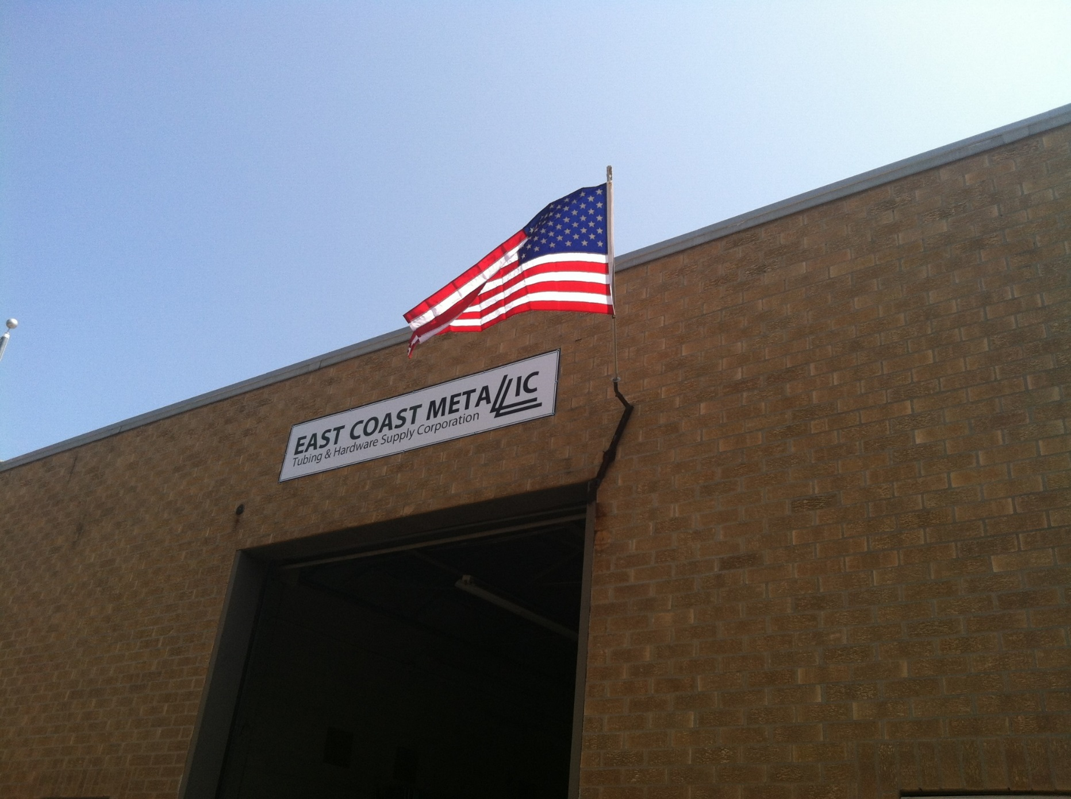
THANK YOU!

